Slide 1

Variable Length Chunking Deduplication
BY
Rahul Agrawal
Shraddha Jadhav
Jagath Sai Narayana
Tanisk Annpurna

Slide 2
Motivations
• The amount of the data posted over the web is increasing exponentially.
• The studies have shown that, among the data posted by people, more than 50 percent of the data is duplicate.
• Storing of duplicate data requires more storage space , time and energy which actually is a waste.
• If we could detect this duplicate data and store only one copy of it, then lot of space and performance time would be saved.

Slide 3
Problem Statement
• To develop an algorithm to detect duplicate data and to maintain a single copy of the data using variable length chunking.

Slide 4
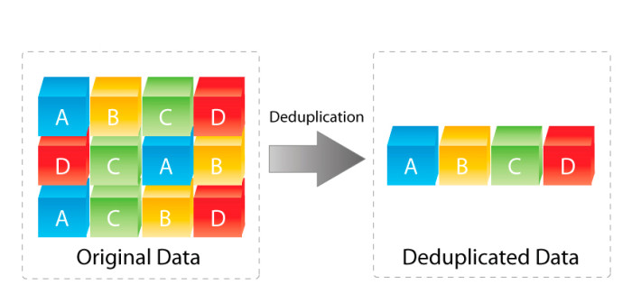
what is data de-duplication ?
Data deduplication refers to a technique for eliminating redundant data in a data set. In the process of deduplication, extra copies of the same data are deleted, leaving only one copy to be stored.
Data is analysed to identify duplicate byte patterns to ensure the single instance of the duplicate part is considered and stored in the server

Slide 5
Why data de-duplication
Requirements shortlist …
It reduces the amount of storage needed for given set of files.
It reduce costs and increase space efficiency in distinct storage environment.
It reduce I/O disk operation.

Slide 6

Deduplication Flow
IS DUPLICATE
YES
NO CHANGE
CHUNKING
DUPLICATE
FILE
NO
HASH TABLE
UPDATE

Slide 7
Fixed Sized Chunking
ABCDEFGHIJKLMNOPQRSTUVWXYZ
ABCDE
FGHIJ
KLMNO
PQRST
UVWXY
Z

Slide 8
Drawback of Fixed Sized Chunking
ABCDEFGHIJKLMNOPQRSTUVWXYZ
ABCDE
FGHIJ
KLMNO
PQRST
UVWXY
Z
ABCDEFGHIJK$#LMNOPQRSTUVWXYZ
ABCDE
FGHIJ
K$#LM
NOPQR
STUVW
XYZ

Slide 9
Variable Length Chunking
ABCDEFGHIJKLMNOPQRSTUVWXYZ
ABC
DEFGHIJ
KLMN
OPQRST
UV
WXYZ
ABCDEFGHIJK$#LMNOPQRSTUVWXYZ
ABC
DEFGHIJ
K$#LMN
OPQRST
UV
WXYZ

Slide 10
Rabin Karp Fingerprinting
A | K | 7 | 0 | 1 | S | F | & | Q | B | . | . | C
A | K | 7 | 0 | 1 | S | F | &
0xffe898
K | 7 | 0 | 1 | S | F | & | Q
0x7fcd12
7 | 0 | 1 | S | F | & | Q | B
0x831765
0 | 1 | S | F | & | Q | B | .
0xaeffee

Slide 11
Hash Table Data Structure
ROLLING HASH
412639232
4b072c939ea61a32d11f74cf47acb28…..
768ae2e492b9193aafa3658c74c39……
2145198080
223ac9d0f8e79288d9a67db1c09f988…...
1237827584
c7c7008f9c35365fb431a4129adc1ec2…..
1459863552
dd1163da4ae793cf8d3d54dea097c5……

Slide 12
In-Memory Data Structure
QUERIES
IN-MEMORY
DATABASE
WITH
PERSISTENCE
THE
MAIN
MEMORY
UPDATES
LOG
TRANSACTION LOG

Slide 13











Overview Uploading
client
Main Server

Slide 14
1.
UPLOAD FILE
Retrieve userId from the user table
Add the file to userFileTable meanwhile userfileid is generated
Obtain the userFileId and add the rolling hash and SHA256 along with the userfFileId into the hashtable.Meanwhile SHAId if each SHA256 value is generated.
Obtain the userFileId and SHAId and add it to the userFileDetails table.It maintains the SHAId along with the file id of the specific file

Slide 15


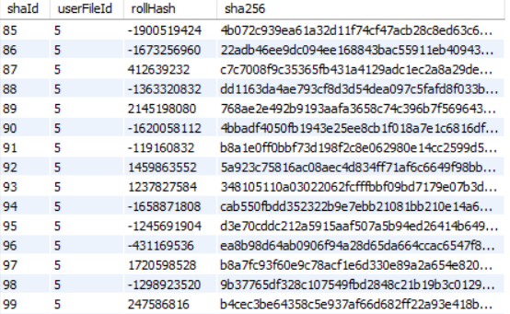
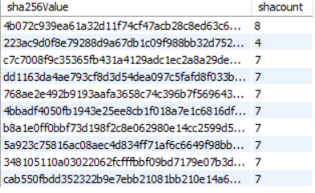
1.
UPLOAD FILE
Retrieve userId from the User table
User will upload a file
Collision
Input File will be divided into chunks of variable length
We also maintain sha256 and its count
Using userFileId compute rolling hash and corresponding Sha256 hash of each chunk

Slide 16
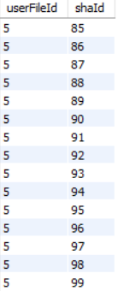
2.
DOWNLOAD FILE
userId 2 can select the file which he/she wants to download
Using userFileId we can retrieve ShaId from FileDetails table
Chunks corresponding to Sha256 are combined into a file and now available for the user to download
Now using these shaId’s we fetch corresponding Sha256

Slide 17

2.
VERSIONING
Version is used to differentiate between the updated data in the existing file.
To maintain versioning in our project we had to add to more columns to our userFile table, which are versionOf and versionNo.
VersionOf column is used to identify to which file the version belongs to.
VersionNo specifies what the version number of the file being uploaded is.
In order to differentiate the file name we have renamed the file with the date and time of updating, just to keep a check.

Slide 18
Conclusion
We have successfully created a program which is able to detect duplicate data and store only one instance of the duplicate data hence improving the resources like storage space, disk I/O operation of the cloud vendors.

Slide 19
References
[ 1 ] J. Wen Xia, Member, IEEE, Hong Jiang, Fellow, IEEE, Dan Feng, Member, IEEE, Fred Douglis, Senior Member, IEEE, Philip Shilane, Yu Hua, Senior Member, IEEE, Min Fu, Yucheng Zhang, and Yukun Zhou, “A Comprehensive Study of the Past, Present, and Future of Data Deduplication”,in 2015
[ 2 ] E. Manogar, S. Abirami,” A Study on Data Deduplication Techniques for Optimized Storage”, 2014 Sixth International Conference on Advanced Computing(lCoAC)
[ 3 ] Changjian Zhang , Deyu QI, Zhe Cai, Wenhao huang,Xinyang wang, Wenlin li1 and Jing guo, “MII: A Novel Content Defined Chunking Algorithm for Finding Incremental Data in Data Synchronization”, 2019, published on July 1, 2019.
[ 4 ] W. Xia, D. Feng, H. Jiang, Y. Zhang, V. Chang, and X. Zou,”Accelerating content-defined-chunking based data deduplication by exploiting parallelism,’’ Future Gener. Comput. Syst., vol. 98, pp. 406–418, Sep. 2019.

